Slide 1
Performance analysis
topic_type & test_type
topic
feature_type
model

Slide 2
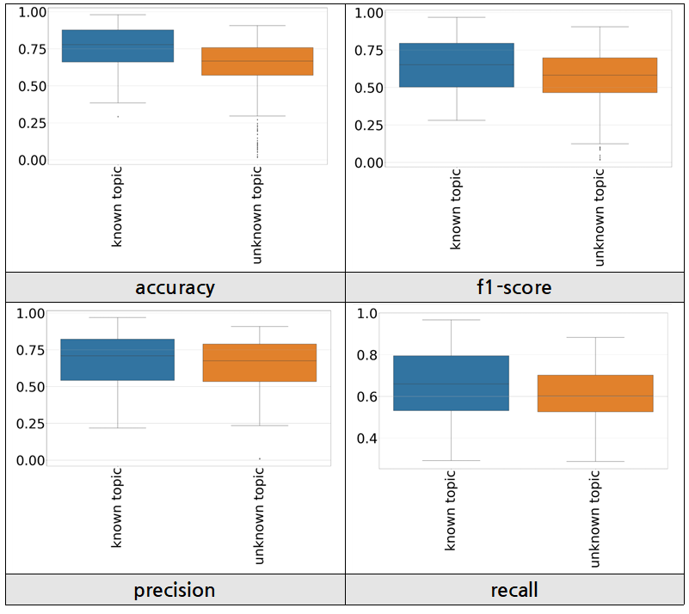
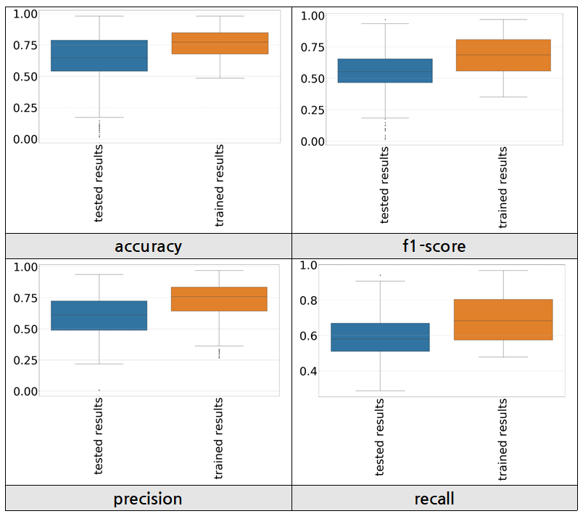
Performance analysis by topic_type & test_type
topic_type : known topic > unknown topic
test_type : trained results > tested results
[ performance analysis by topic_type ]
[ performance analysis by test_type ]

Slide 3
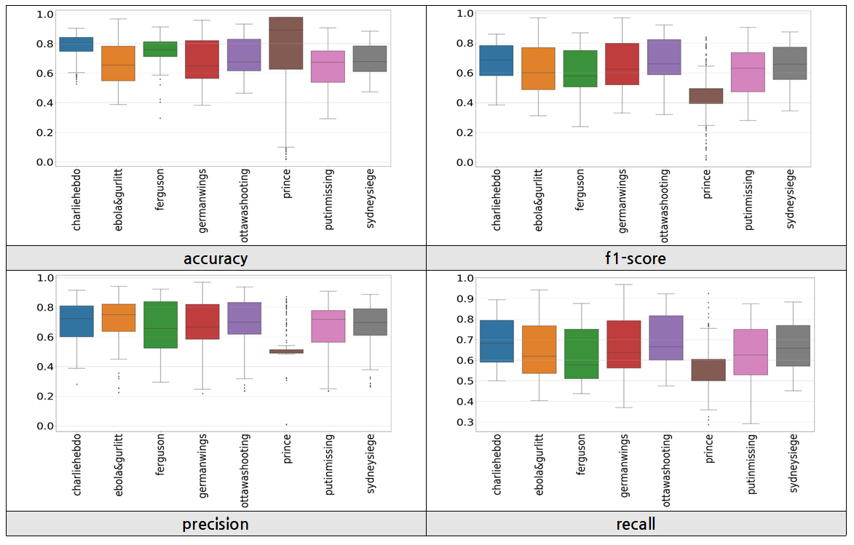
Performance analysis by topic
Why does prince, ferguson, and charliehebdo have higher values in accuracy than other performance_type? - This is because each dataset is biased to one side of the rumor or non-rumor.
The case with more non-rumor data - ferguson, charliehebdo (4 times)
The case with more rumor data - prince (57 times)

Slide 4
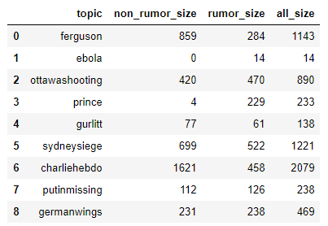
Performance analysis by topic
The size of each topic's dataset is shown in the table to the right.
In case of prince, it only has 4 non-rumor data. So, one or more hits and wrongs have a big impact on precision, recall, and f1.

Slide 5
Performance analysis by topic
Precision, recall, f1 examples of prince data
< confusion matrix #1 >
< confusion matrix #2 >
 | 0 | 1
0 | 1 | 3
1 | 9 | 220
TP | FN | recall
1 | 3 | R(0) = 0.25
220 | 9 | R(1) = 0.96
 | 0 | 1
0 | 3 | 1
1 | 9 | 220
TP | FN | recall
3 | 1 | R(0) = 0.75
220 | 9 | R(1) = 0.96
TP | 1 | 220
FP | 9 | 3
precision | P(0) = 0.1 | P(1) = 0.98
TP | 3 | 220
FP | 9 | 1
precision | P(0) = 0.25 | P(1) = 0.995
- accuracy : 221/233 = 0.948 - precision : (P(0) + P(1)) / 2 = 0.54 - recall : (R(0) + R(1)) /2 = 0.605 - f1-score : 2 x {(precision x recall) / (precision +recall)} : 0.57
- accuracy : 223/233 = 0.957 - precision : (P(0) + P(1)) / 2 = 0.623 - recall : (R(0) + R(1)) /2 = 0.855 - f1-score : 2 x {(precision x recall) / (precision +recall)} : 0.72

Slide 6
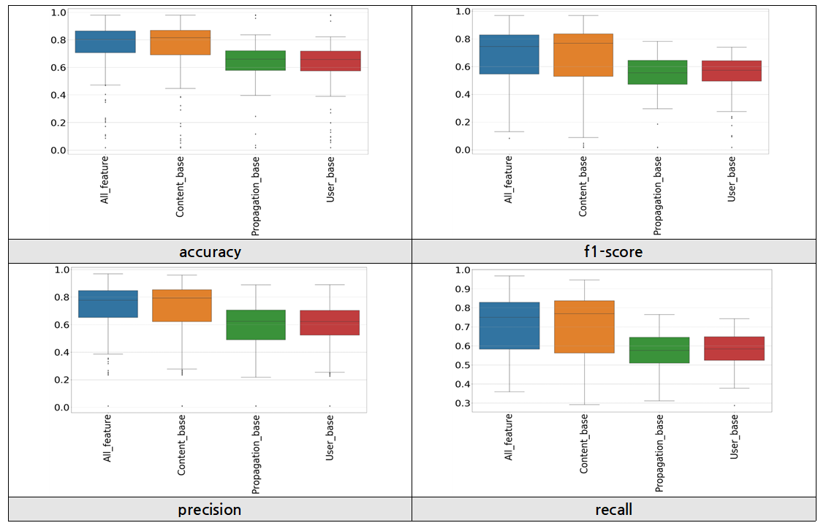
Performance analysis by feature_type
All_feature, Content_base in feature_type show high overall performance.

Slide 7
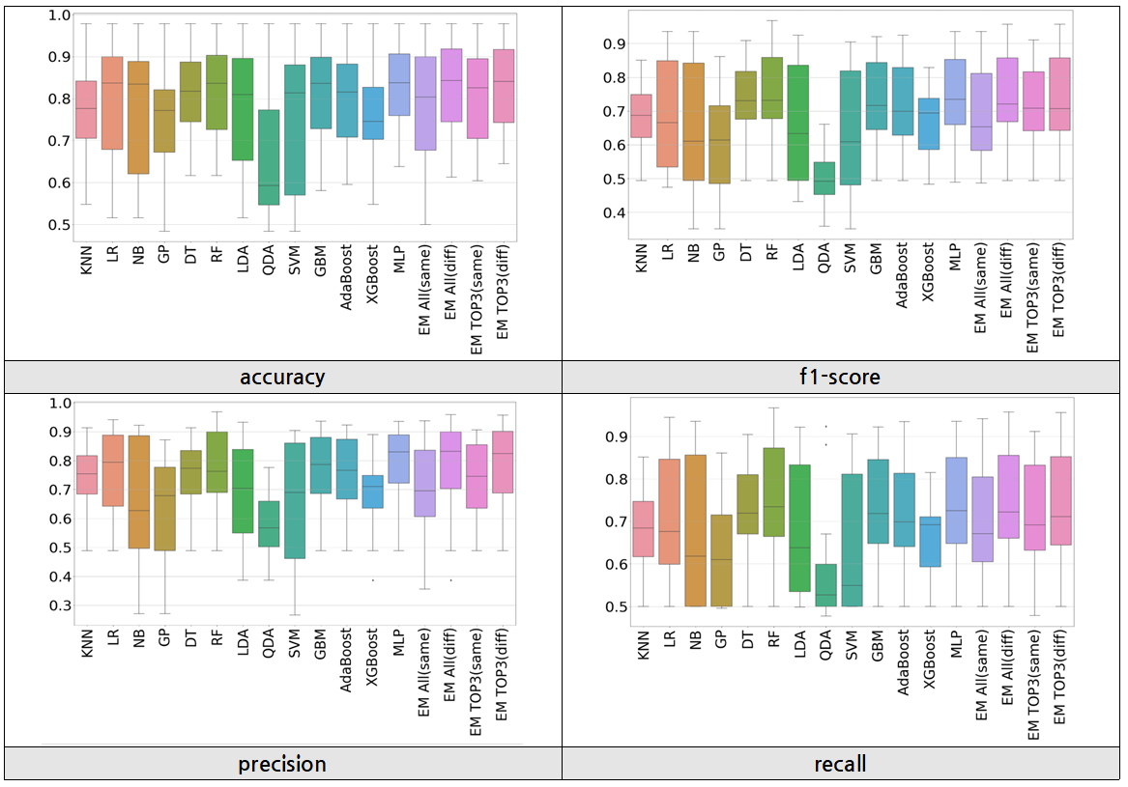
Performance analysis by model (「known topic 」-「trained results」)
The performance analysis by model was divided into four categories as follows. - 「known topic 」-「trained results」 - 「known topic 」-「tested results」 - 「unknown topic 」-「trained results」 - 「unknown topic 」-「tested results」
The results of the ensemble (EM) do not show much difference from the performance of other models.

Slide 8
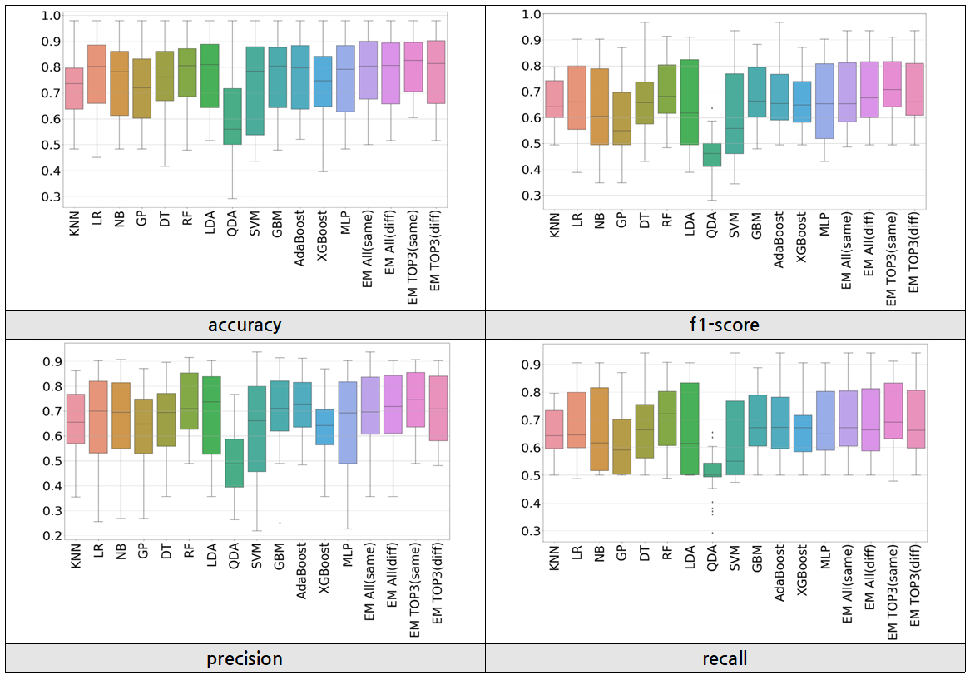
Performance analysis by model (「known topic 」-「tested results」)
The performance of QDA is the lowest overall.
The results of the ensemble (EM) do not show much difference from the performance of other models.

Slide 9
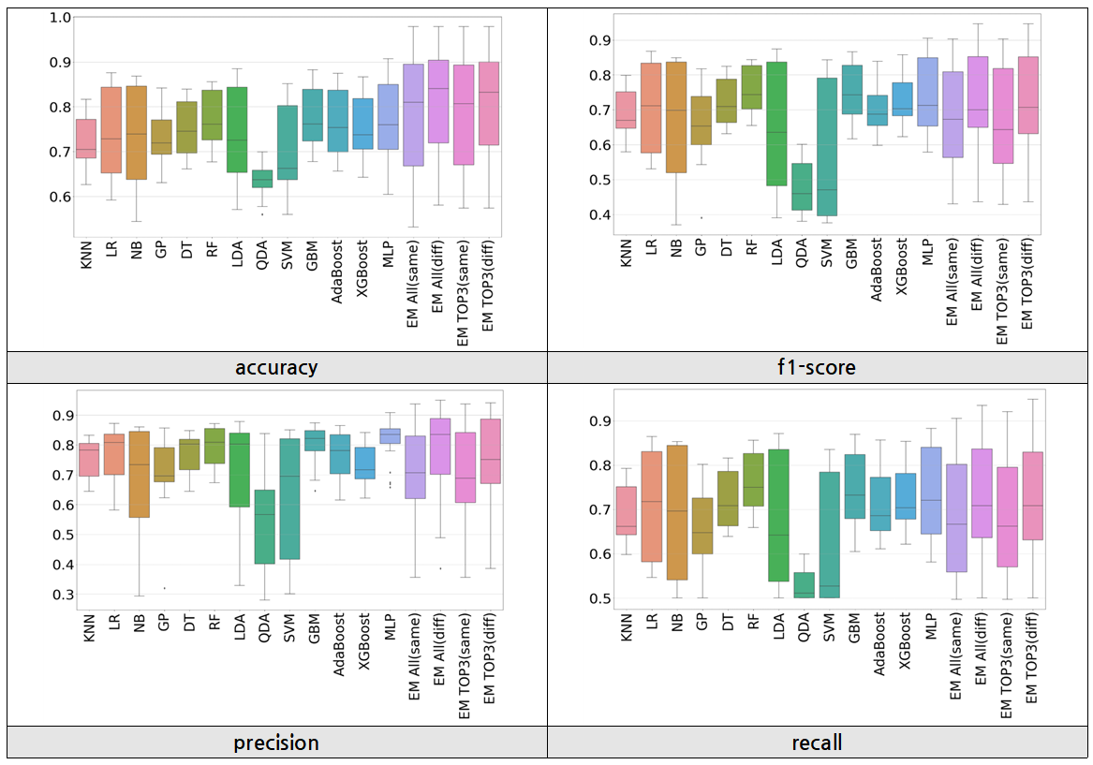
Performance analysis by model (「unknown topic 」-「trained results」)
For models with a large variation in performance values compared to other models, the following can be inferred. - It is sensitive to the value of the parameter. - It is greatly affected by the feature type.
The results of the ensemble (EM) do not show much difference from the performance of other models.

Slide 10
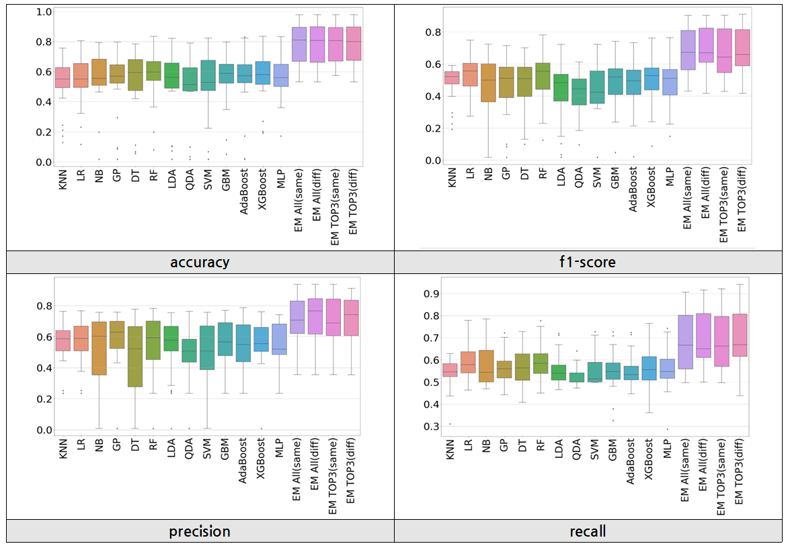
Performance analysis by model (「unknown topic 」-「tested results」)
Overall, The results of the ensemble(EM) show much difference from the performance of other models.

